Slide 1


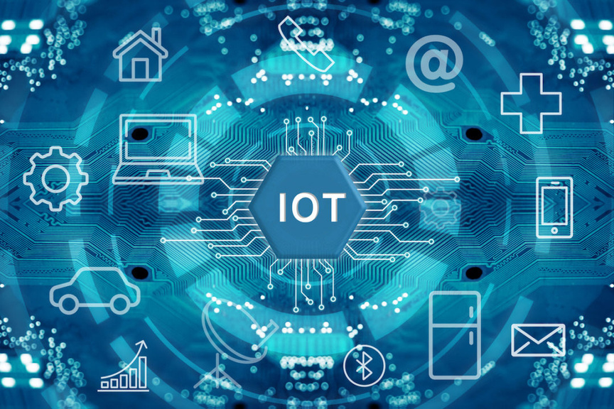

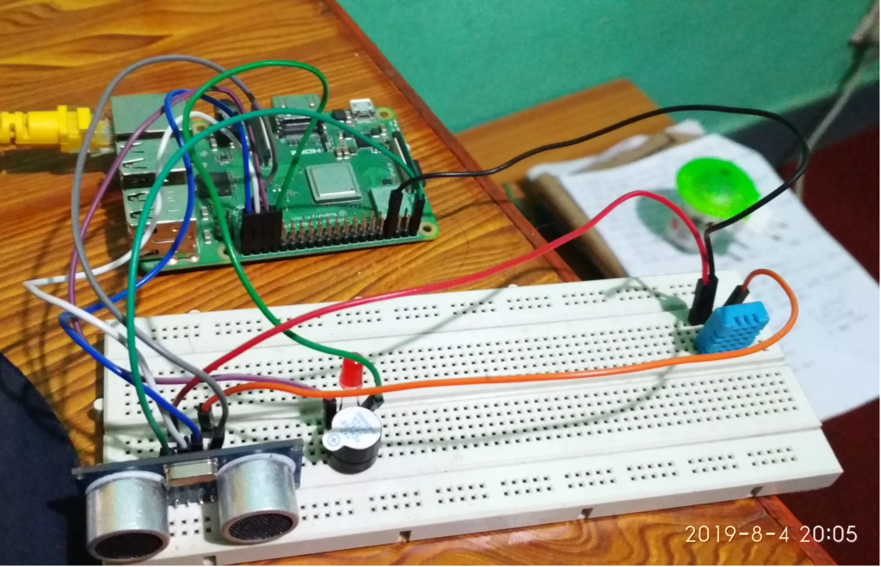
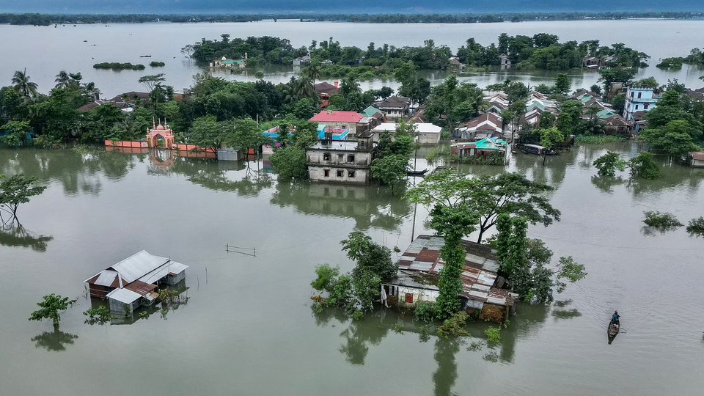


Early Flood, Detection and Avoidance System
Presented by
Umma Habiba Eti
Sharmin Jahan Sathi

Slide 2



MEET THE TEAM
Umma Habiba Eti
Dept: CSE
Jahangirnagar University
50th Batc
Sharmin Jahan Sathi
Dept: CSE
Jahangirnagar University
50th Batch

Slide 3
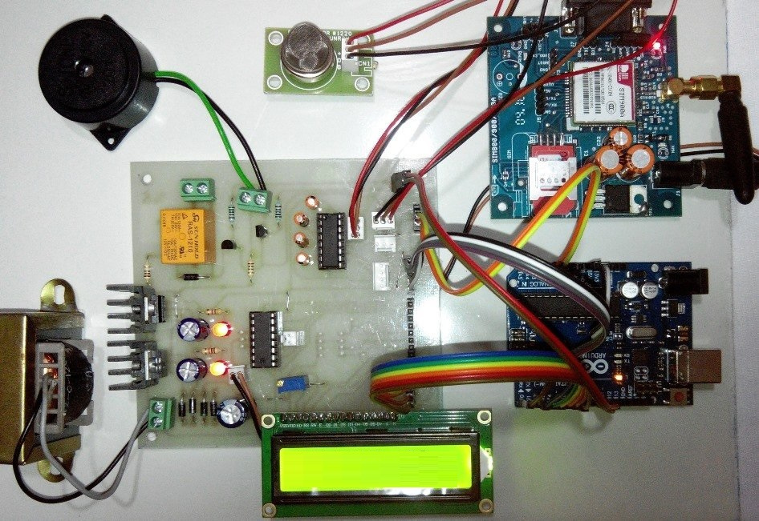
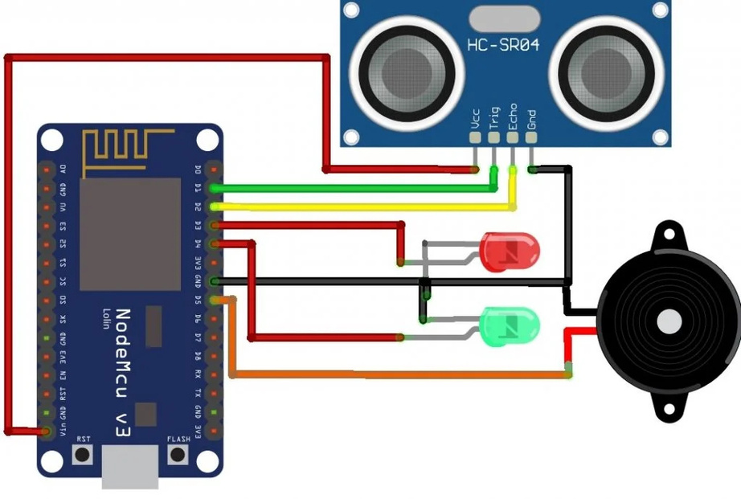

SUMMERY
The Early Flood Detection and Avoidance System is an IoT-based project designed to monitor environmental and hydrological parameters in flood-prone areas. It provides early warnings about potential floods, helping to prevent or mitigate damage to life and property.
This project provides a simple, affordable, and effective tool for disaster management in flood-prone areas. It empowers individuals and agencies to respond proactively to flood threats, potentially saving lives and reducing economic losses.

Slide 4
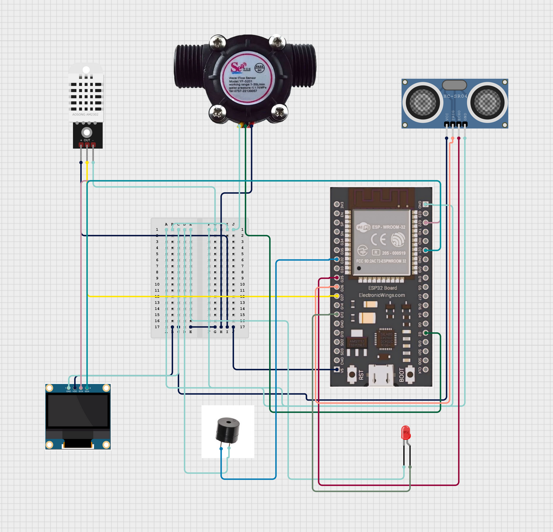
Circuit Diagram

Slide 5


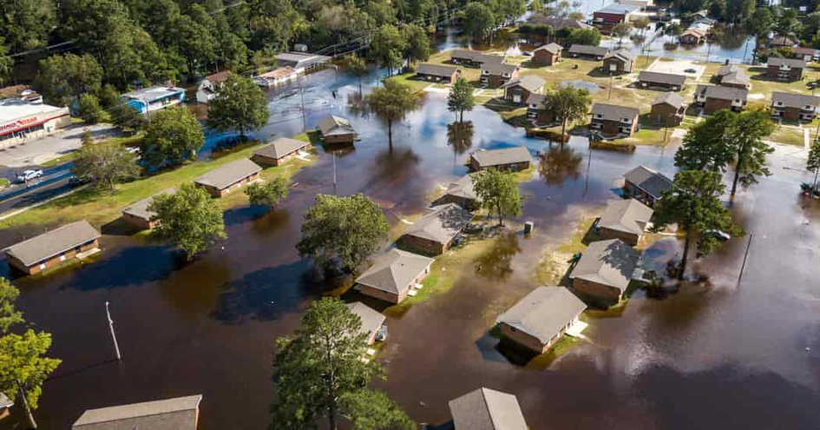
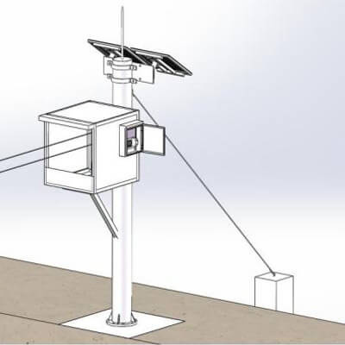
APPLICATION
1.Early Warning System
2.Monitoring Flood-Porne Areas
3.Irrigation Management
4.Crop Protection
5.Infrastructure Protection
6.Smart Monitoring
7.Community Safety
8.Water Treatment plants
9.Ecosystem Protection
10.Dam Operation

Slide 6
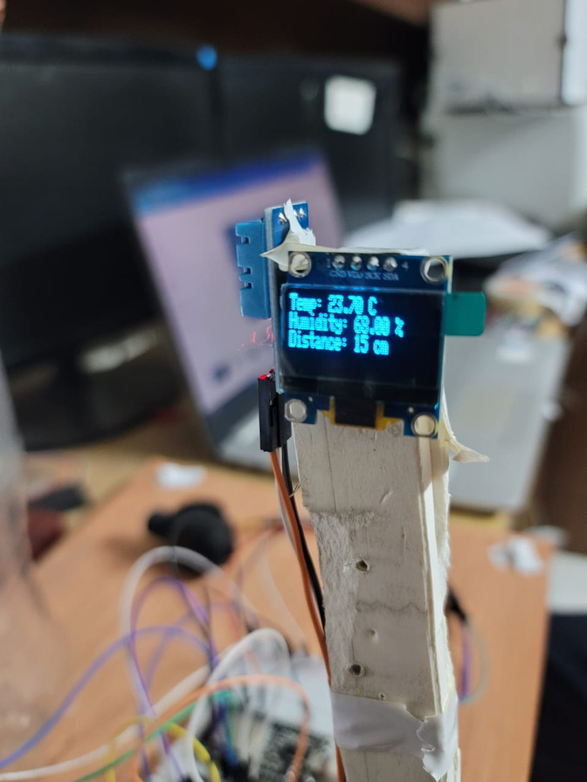
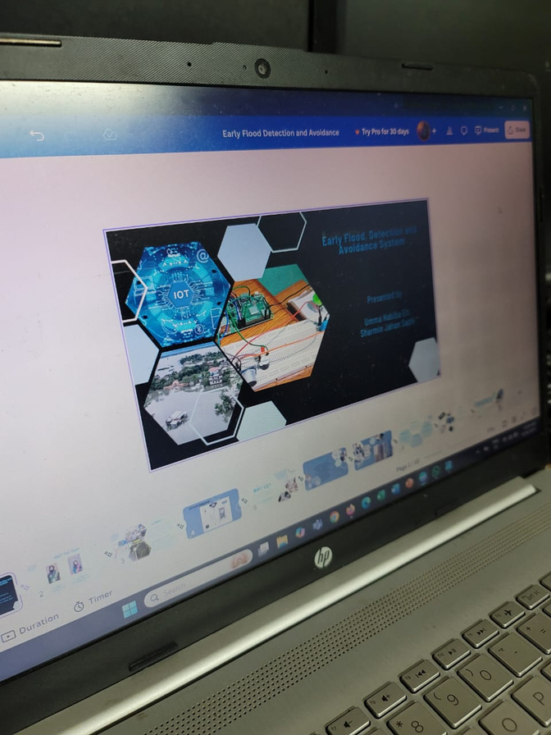
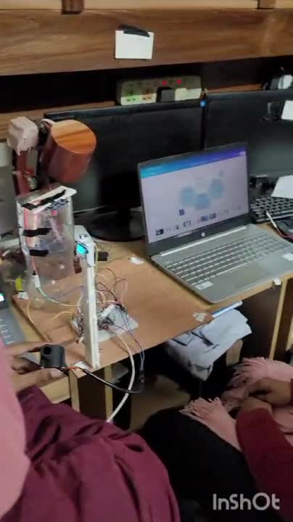
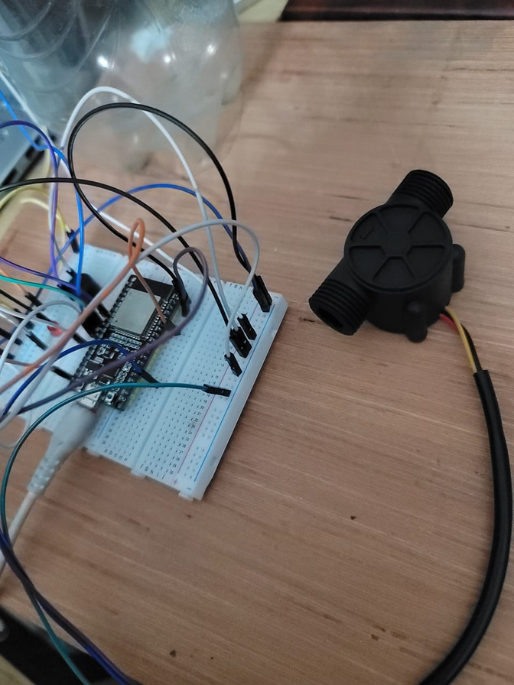

Slide 7

Insperation
The Early Flood Detection and Avoidance System draws significant inspiration from real-world challenges, particularly the devastating 2024 Bangladesh Flood Incident, which highlighted the urgent need for effective flood monitoring and early warning systems.
2024 BANGLADESH FLOOD INCIDENT: A CALL FOR ACTION
Lessons Lerned
1.Loss of Lives and Property
2.Delayed Warning
3.Vulnerability of Flood-Porne Regions
4.Impact on Agriculture
1.Early Warning System save lives
2.Technology Gap
3.Community Preparedness
INSPERATION FROM RESILIENCE
Bangladesh's resilience and the proactive measures taken by its communities during the 2024 floods inspired this project to focus on practical solutions. By integrating IoT and modern technology, this system aims to empower flood-prone regions with tools to protect lives and livelihoods in the future.

Slide 8
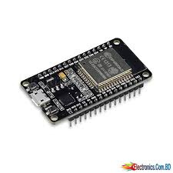
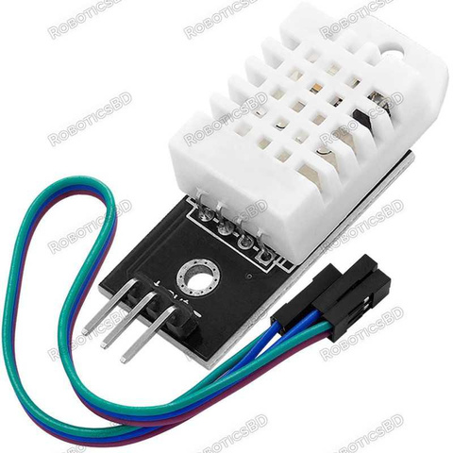
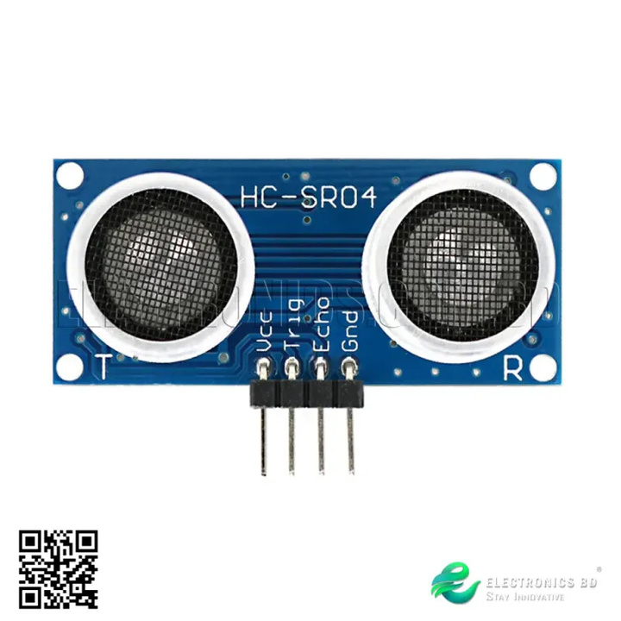
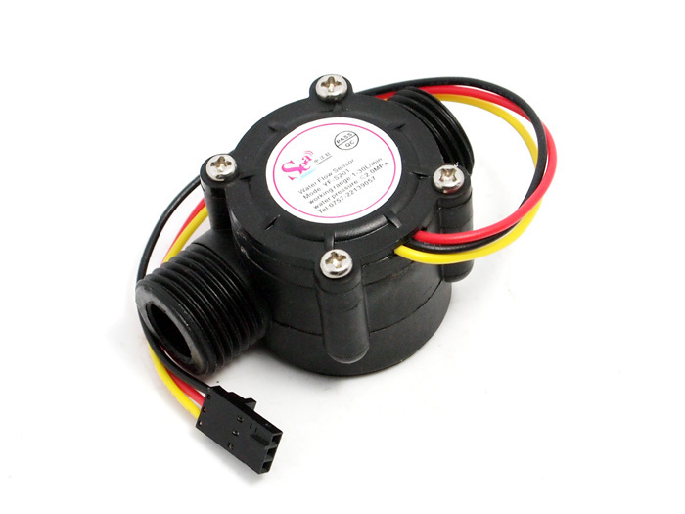
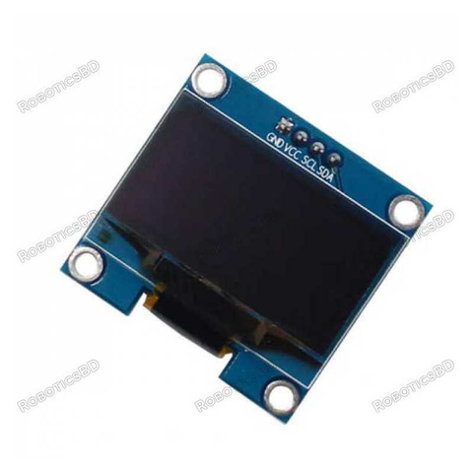
COST
1.ESP-32: 380 tk
2.DHT-22: 320 tk
3.Ultrasonic Sensor:75 tk
4.Water Flow Sensor: 430 tk
5.OLED:300 tk
6.LED:5 tk
7.Breadboard:55 tk
8.Connectiong Wires(m-m,f-f):150 tk

Slide 9



CONTACT US
01744764242
01719186576
https://bd.linkedin.com/in/sharmin-jahan-sathi-a47103329
https://www.linkedin.com/in/umma-habiba-eti-57ba77328/
https://github.com/Sharmin-jahan-sathi
https://github.com/Umma-Habiba-Eti
sharminjahan12th@gmail.com
ummahabibaeti@gmail.com

